Slide 1


Build
Pitch
Win
Mentorship
Portal
Made By: Piya Kakar, Vidit Sharma
University: IILM UNIVERSITY, Gurugram

Slide 2

Mentorship Portal
Mentorship Portal
Problem Statement
  Students often face difficulty in accessing timely and relevant guidance for academics, internships, research, career planning, and personal growth.
  Although alumni, senior students, and faculty are willing to mentor, there is no centralized platform to connect mentors and mentees in a structured and transparent way.

Slide 3
Mentorship Portal
Mentorship Portal
Objectives
  Provide a centralized mentorship platform for our college
  Make guidance easily accessible and transparent
  Enable structured mentor–mentee connections
  Support students in academics, careers, and personal growth

Slide 4
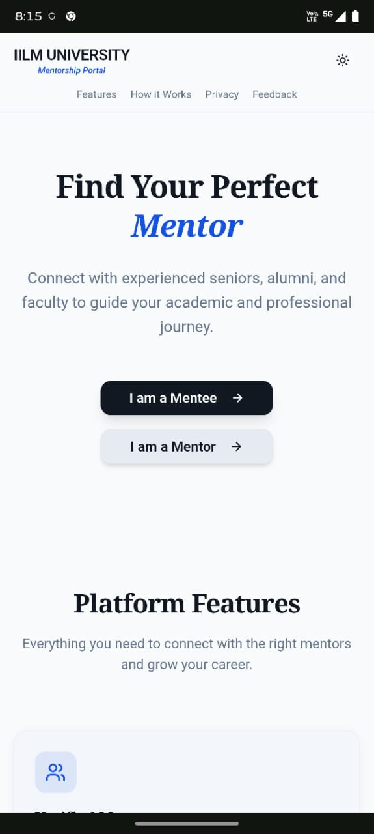
Mentorship Portal
Our Proposed
Solution
Mentorship Portal – Website
  A user-friendly mentor–mentee connection platform
  Designed specifically for college students and mentors
  Allows students to discover mentors, send requests, and track mentorships
  Clean and professional front page showcasing platform features

Slide 5
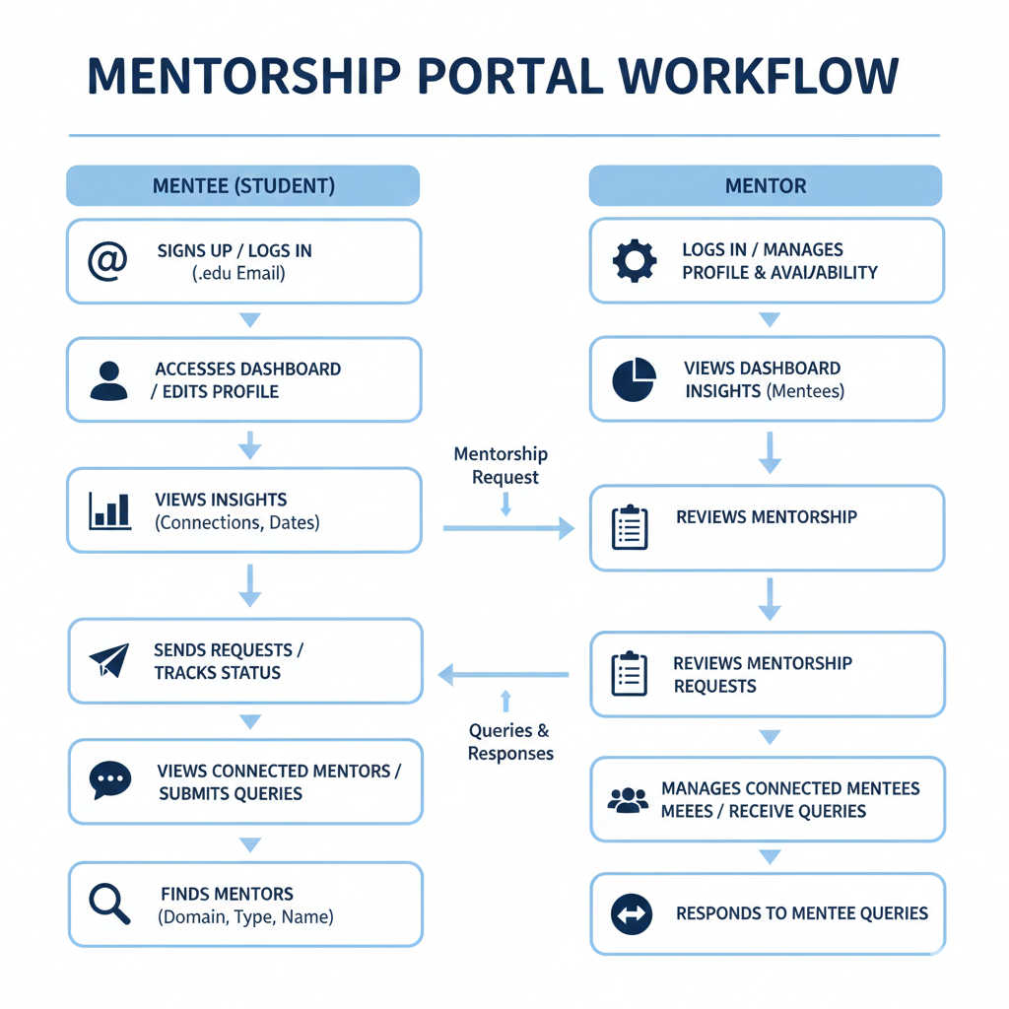
Mentorship Portal
Mentorship Portal
Mentor
Mentee

Slide 6
Mentorship Portal
Mentorship Portal
Tech Stack
AI & DESIGN TOOLS:
  ChatGPT (Prompts Generation)
  Lovable (Functional Website)
  Canva (Logo & PPT design)
& AI Tools
FRONTEND:
BACKEND:
  React
  Tailwind CSS
  JavaScript
  Supabase
REPOSITORY
DEPLOYMENT
  Github
  Vercel

Slide 7

Mentorship Portal
Future
Enhancements
  Email and in-app notifications
  Improved security and role-based access
  In-platform chat between mentor and mentee
  Feedback and rating system
  Advanced analytics and insights

Slide 8
Mentorship Portal
Thank
You!
We will now demonstrate the working prototype of our
Mentorship Portal.

